Slide 1


U.S Housing Market of 2018

Slide 2

Overview
Economics Updates
U.S. Housing Markets
Predictions
Sales Pitch

Slide 3
Economic Updates
The U.S. economy grew 3.1% in 2018, which was the fastest rate since 2005. The economy expanded 4.2% in the second quarter, but growth slowed to 3.4% in the third quarter and continued to soften at the end of the year. The government previously estimated that the economy grew 3%, but later downgraded its estimate to 2.5%.The growth was significantly lower than the last year. As a whole, the economy grew 2.9 percent.
In 2018, the total value of the U.S. housing market increased $1.9 trillion, propelling its value to a whopping $33.3 trillion, according to new data from Zillow. Zillow highlights that this 6.2% increase is up $10.9 trillion from 2012, when the housing market crashed.

Slide 4
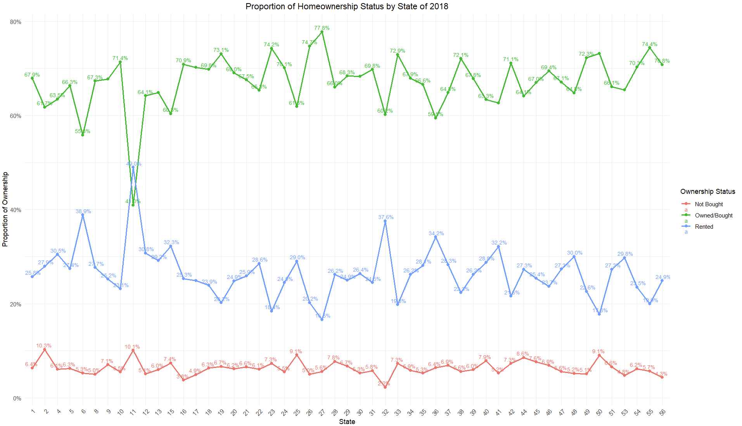
Insights of U.S. State Housing Market 2018
Data is sorted by age >= 18 & age <= 64
The analysis is done on Homeownership (ownership) of U.S as per ACS (American Community Survey)
The proportion of Homeownership for owned/bought is highest in Minnesota(27) and lowest in District of Columbia (11). While other states falls under 75%
Whereas, the proportion of Homeownership for rented is highest in District of Columbia (11) and lowest in Minnesota(27). Here the other states are below 40%.
Meanwhile, each state has approximately 10.3% or less unknown status, which collectively amounts to 5.77% unknown status across the U.S.

Slide 5
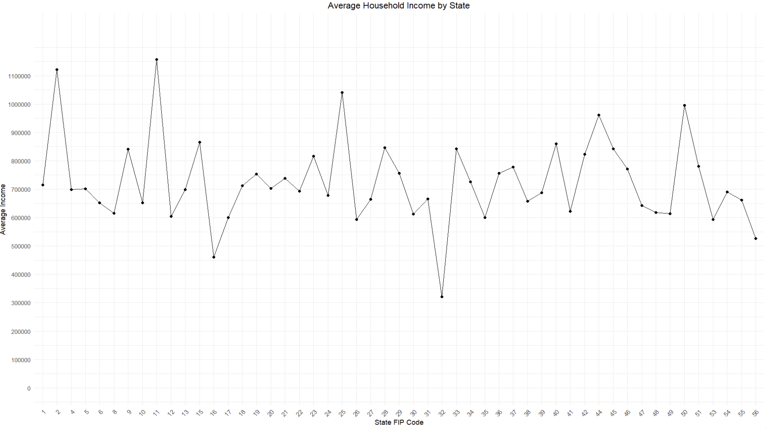
Average Household Income by State :
This data demonstrates that District of Columbia (11) has the highest average household income and the second highest shows for Alaska (02) for the year 2018.
While the lowest average household income is Nevada (32).
The line connecting points on the graph helps visualize trends and changes in average income across the states, while the points mark the actual data points for each state’s average income. The use of both points and lines helps clarify exact values and the overall trend.

Slide 6
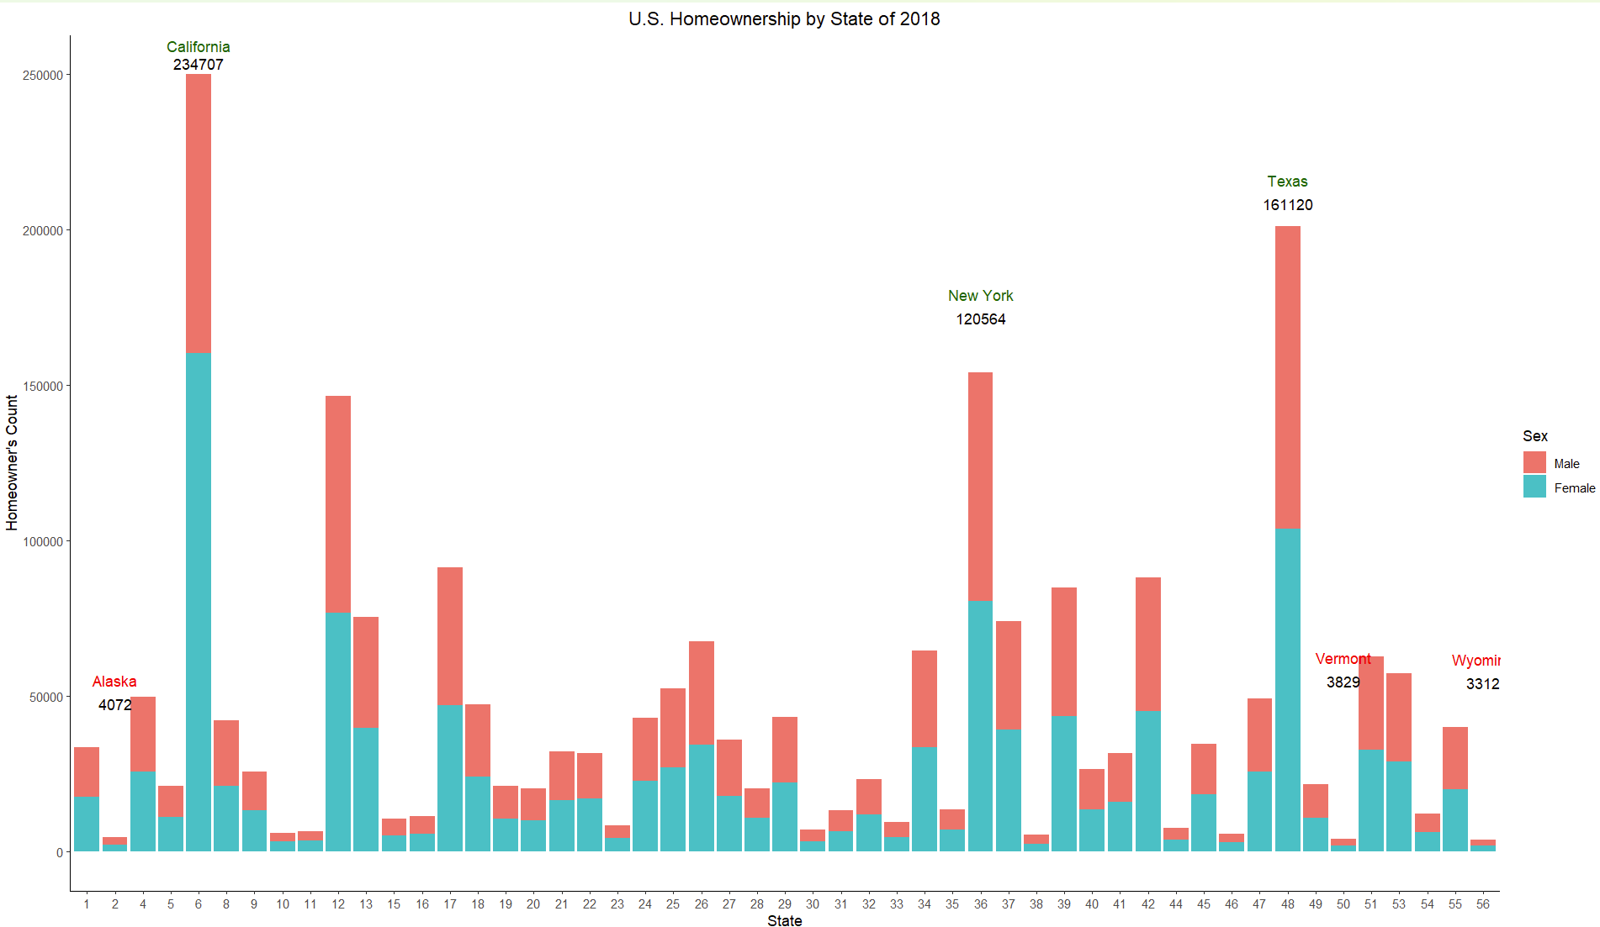
California leads with over 234,000 homeowners, predominantly females, marking it as a critical market for residential developers and real estate marketers.
Texas and New York follow with more than 161,000 and 120,000 homeowners, respectively, with a balanced gender distribution among homeowners.
In contrast, Alaska, Vermont, and Wyoming present much lower figures, each with fewer than 5,000 homeowners, suggesting different market dynamics and possibly different housing challenges.
The gender segmentation of homeownership in these leading states indicates potential preferences or economic factors influencing home buying behaviors among males and females. Other states collectively fall below the 130k homeownership mark, underscoring regional variations
The data illustrates the geographic areas and socioeconomic characteristics like gender as a significant demographic factor for targeted marketing and planning strategies in the real estate sector. Such insights are crucial for developing future predictions and tailoring approaches to meet specific market needs.

Slide 7
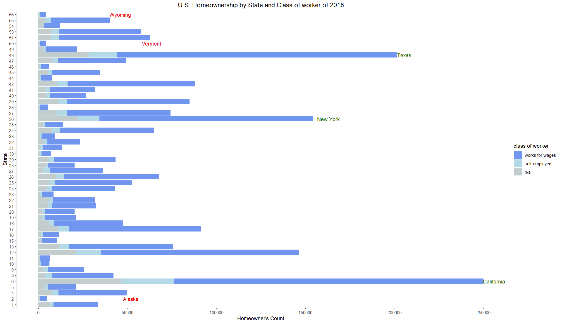
U.S. Homeownership by State & Class of Workers:

Slide 8
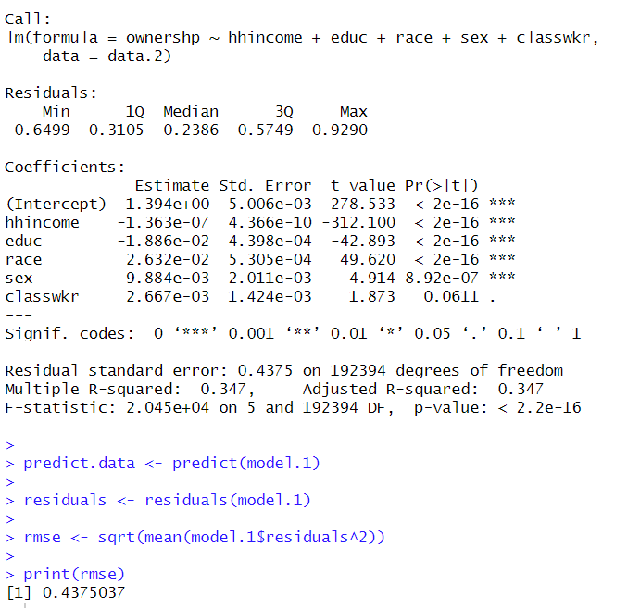
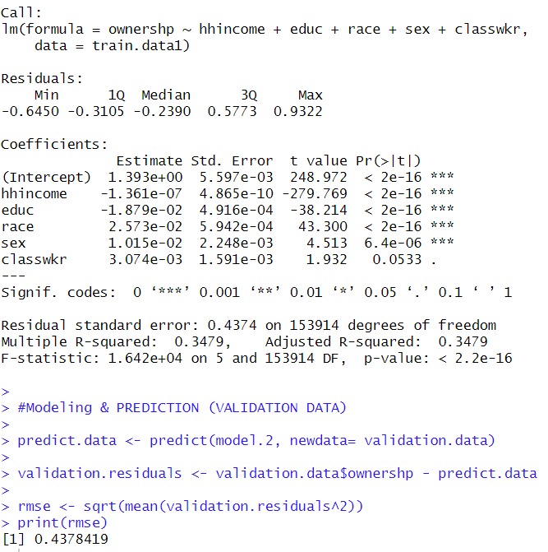
Predictions using Linear Model
The prediction has been done on Linear Regression Model where input for the Linear regression Model is Ownership of dwelling (ownership) and predictors used here are total household income(hhincome), Education(educ), race, sex and Class of worker.
This script performs several steps using R, mainly focused on data manipulation, linear regression modeling, prediction, and evaluation of a model using RMSE (Root Mean Square Error).
After sampling the data ,the data is splitted in Training data for 80% and Validation data for 20% to avoid overfitting and to give more precise and generalize new outcome.
Then the data is predicted on the validation datasets and RMSE is calculated.

Slide 9
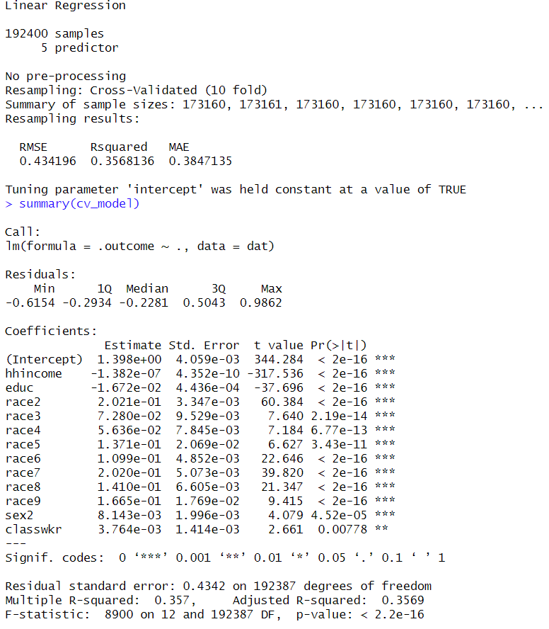
K- Fold Cross Validation Method :
The K-fold cross-validation method involves dividing the dataset into 10 parts, training the model on 9 parts, and validating on the 1 remaining part. The key benefit of using cross-validation in this context is to minimize overfitting, ensuring that the model's performance metrics are not overly optimistic and more reflective of its expected performance.
K-fold cross-validation helps us to check if our statistical model works well by testing. It gives us a good overall idea of how accurate our predictions are and this method enhances our confidence that the model will perform effectively in real-world scenarios, offering dependable predictions on new data.
Prediction done in different ways | Root Mean Square Error (RMSE)
Simple Prediction using Linear Model | 0.4375037
Splitting Data into Training 80% & validation 20% | 0.4378419
K- Fold Cross Validation | 0.434196

Slide 10

Sales Pitch
In a world where data is king, having the right analysis tools is crucial for making informed decisions, particularly in real estate and urban development. Our tailored R script efficiently processes large datasets to give you clear insights into homeownership patterns across various states, focusing specifically on adults aged 18 to 64. This focus helps in providing with the most relevant and actionable data.
Key Features:
Thorough Data Preparation: Staring with cleaning and organizing the data to ensure accuracy in our analysis.
Detailed Insights: Discover detailed trends in homeownership, such as who is buying homes and who is renting, looking at the average household income across state and then the data is broken down by gender, class of workers and state. This information is invaluable for targeted marketing campaigns and policy making.
Clear Visuals: Our charts and graphs make complex data easy to understand at a glance. Identify key trends in homeownership with our visually appealing and informative displays.
Predictive Analysis: Used Linear models to predict future trends based on income, education, race, sex and Class of workers helping plan better for the future.
Validated Models: Our process includes rigorous validation steps to ensure our predictions are both reliable and robust.
Conclusion:
Our analysis isn’t just about numbers—it’s about turning data into strategic action. Ideal for anyone in real estate or urban planning, this tool puts comprehensive data analysis and helping to make well-informed decisions that lead to real-world successes.
This shows this can benefit real estate and urban planning professionals by providing clear, actionable insights derived from complex data analysis.

Slide 11

Thank you!

